Slide 1
DISCLOSURE
I do not have financial or any other relevant relationships with commercial interest to disclose.

Slide 2
Learning Objectives
By the end of the session, participants will be able to:
Describe…
Recognize…
Evaluate…
Explain…

Slide 3
DISCLOSURE
I do have a financial or any other relevant relationships with commercial interest and control over educational content related to the products and/services of the commercial interest(s) to disclose.
• Your name
• Relationship(s) to the commercial interest
• Name of the commercial interest
• No logos or product endorsements

Slide 4
DISCLOSURE
The Scientific Planning Committee has reviewed all disclosed financial and relevant relationships of speakers, moderators, facilitators, and/or authors in advance of this CPD activity and has implemented procedures to manage any potential or real conflicts of interest.
Scientific Planning Committee - Organizer

Slide 5
In support of improving patient care, Sidra Medicine is jointly accredited by the Accreditation Council for Continuing Medical Education (ACCME), the Accreditation Council for Pharmacy Education (ACPE), the Ministry of Public Health’s Department of Healthcare Professions-Accreditation Section, and the American Nurses Credentialing Center (ANCC), to provide continuing education for the healthcare team.

Slide 6
Activity title
Activity Code
TOPIC
Presenter: xxx
Learning Objectives
Outline XXX
Describe XXX
Illustrate XXX
Explain XXX
Compare XXX
Date: xx 2022
Time: xx
Venue: LIVE STREAMING Live streaming link
Target Audience: Physicians, Nurses, Allied Health, Pharmacy
JOINT ACCREDITATION STATEMENT AND PLANNING COMMITTEE DISCLOSURE
In support of improving patient care, Sidra Medicine is jointly accredited by the Accreditation Council for Continuing Medical Education (ACCME), the Accreditation Council for Pharmacy Education (ACPE), the Ministry of Public Health’s Department of Healthcare Professions-Accreditation Section, and the American Nurses Credentialing Center (ANCC), to provide continuing education for the healthcare team.
The Scientific Planning Committee has reviewed all disclosed relevant relationships of speakers, moderators, facilitators, and/or authors in advance of this CPD activity and has implemented procedures to manage any potential or real conflicts of interest.
This activity is an Accredited Group Learning Activity (Category 1) as defined by the Ministry of Public Health’s Department of Healthcare Professions-Accreditation Section and is approved for a maximum of 1 hour for Category 1

Slide 7
Scan the QR Code to register your attendance.
After the session, once the administrator has confirmed your attendance, go directly to My CE on the Cloud CME website or to the CloudCME App to complete your auto-assigned evaluation.
You will receive a transcript and a certificate.
If an evaluation is not available check with your activity administrator to ensure they have validated your attendance and assigned the evaluation.

Slide 8
IMPORTANT
Scan the QR code only during the live session.
The QR code works only during the LIVE event.
No credit or certificates is issued for recorded sessions.
The evaluation forms will be available after your attendance has been validated by the activity owners which can take up to a week. Certificates will be available to download upon completion of your evaluation forms
SCAN the QR Code NOW
INSERT THE CODE

Slide 9
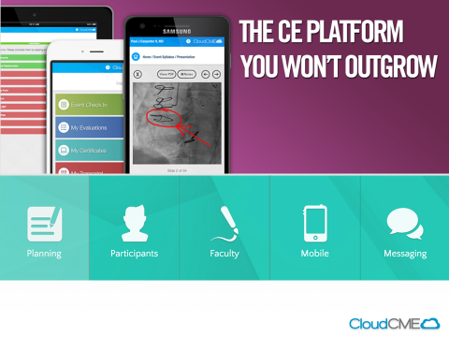
CloudCME Free App for Android and iPhone
Organizational Password:
Sidra

Slide 10
CloudCME Sidra Portal
External website – situated on the Cloud, does not require Sidra networks to sign in.
Copy and paste the address into your google chrome browser at home or at work:
https://sidra.cloud-cme.com/default.asp

Slide 11
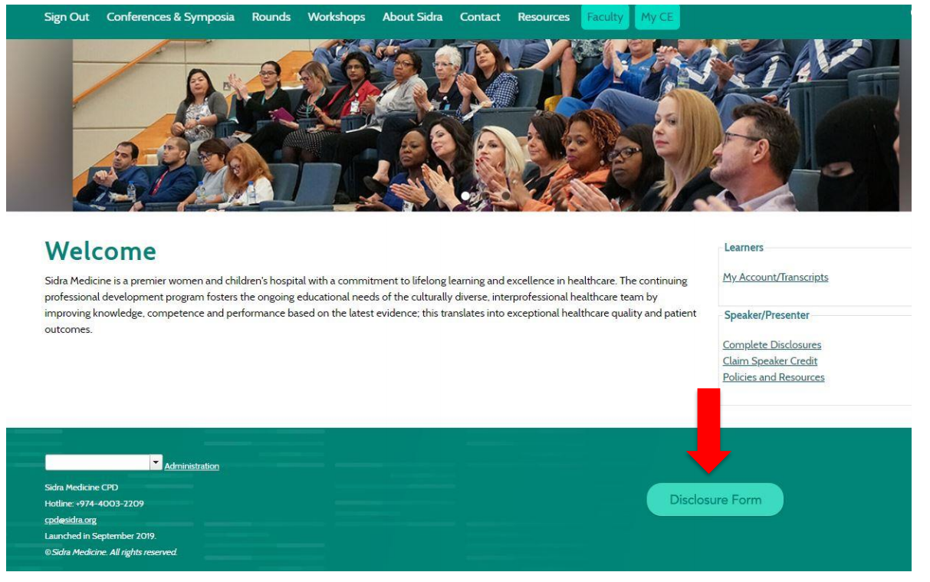
Are you a speaker, moderator, facilitator or planner?
Complete your DISCLOSURE

